Slide 1
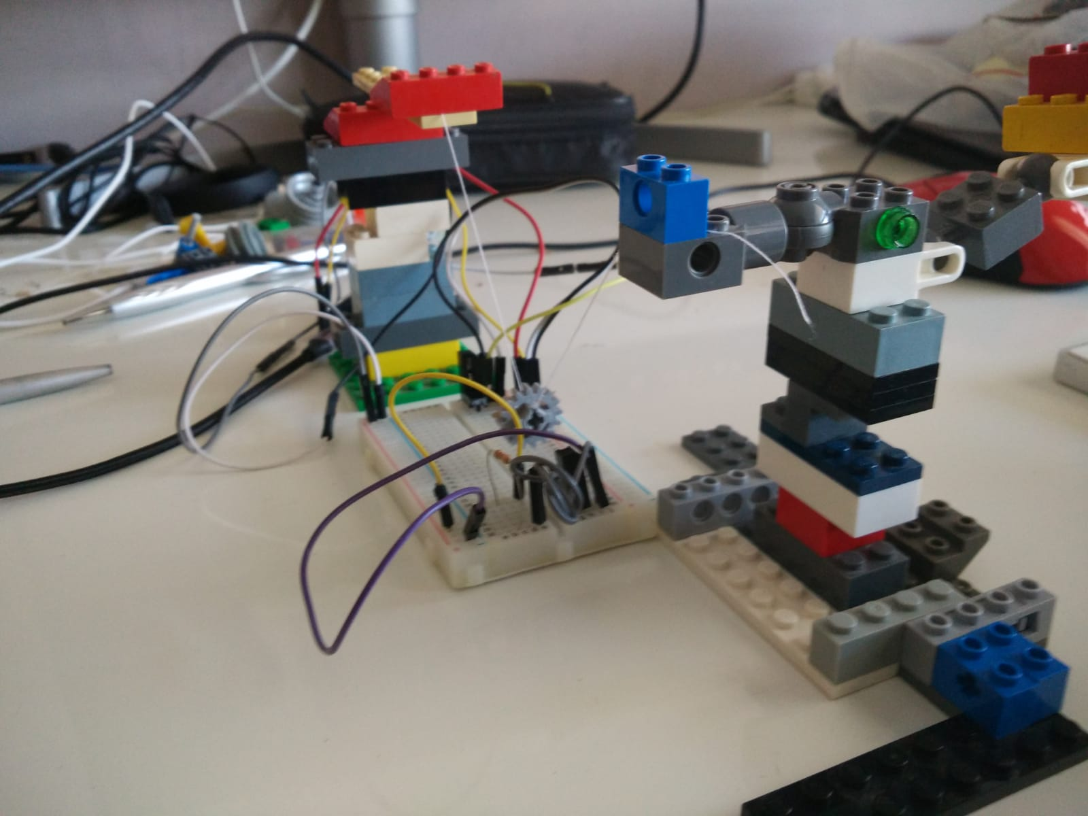
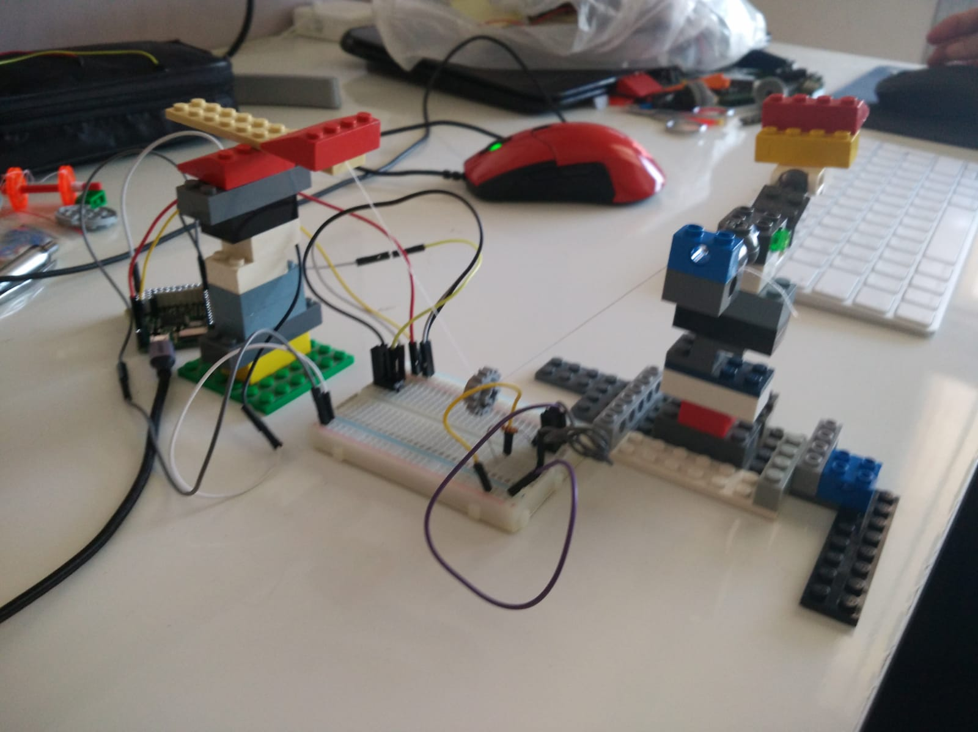
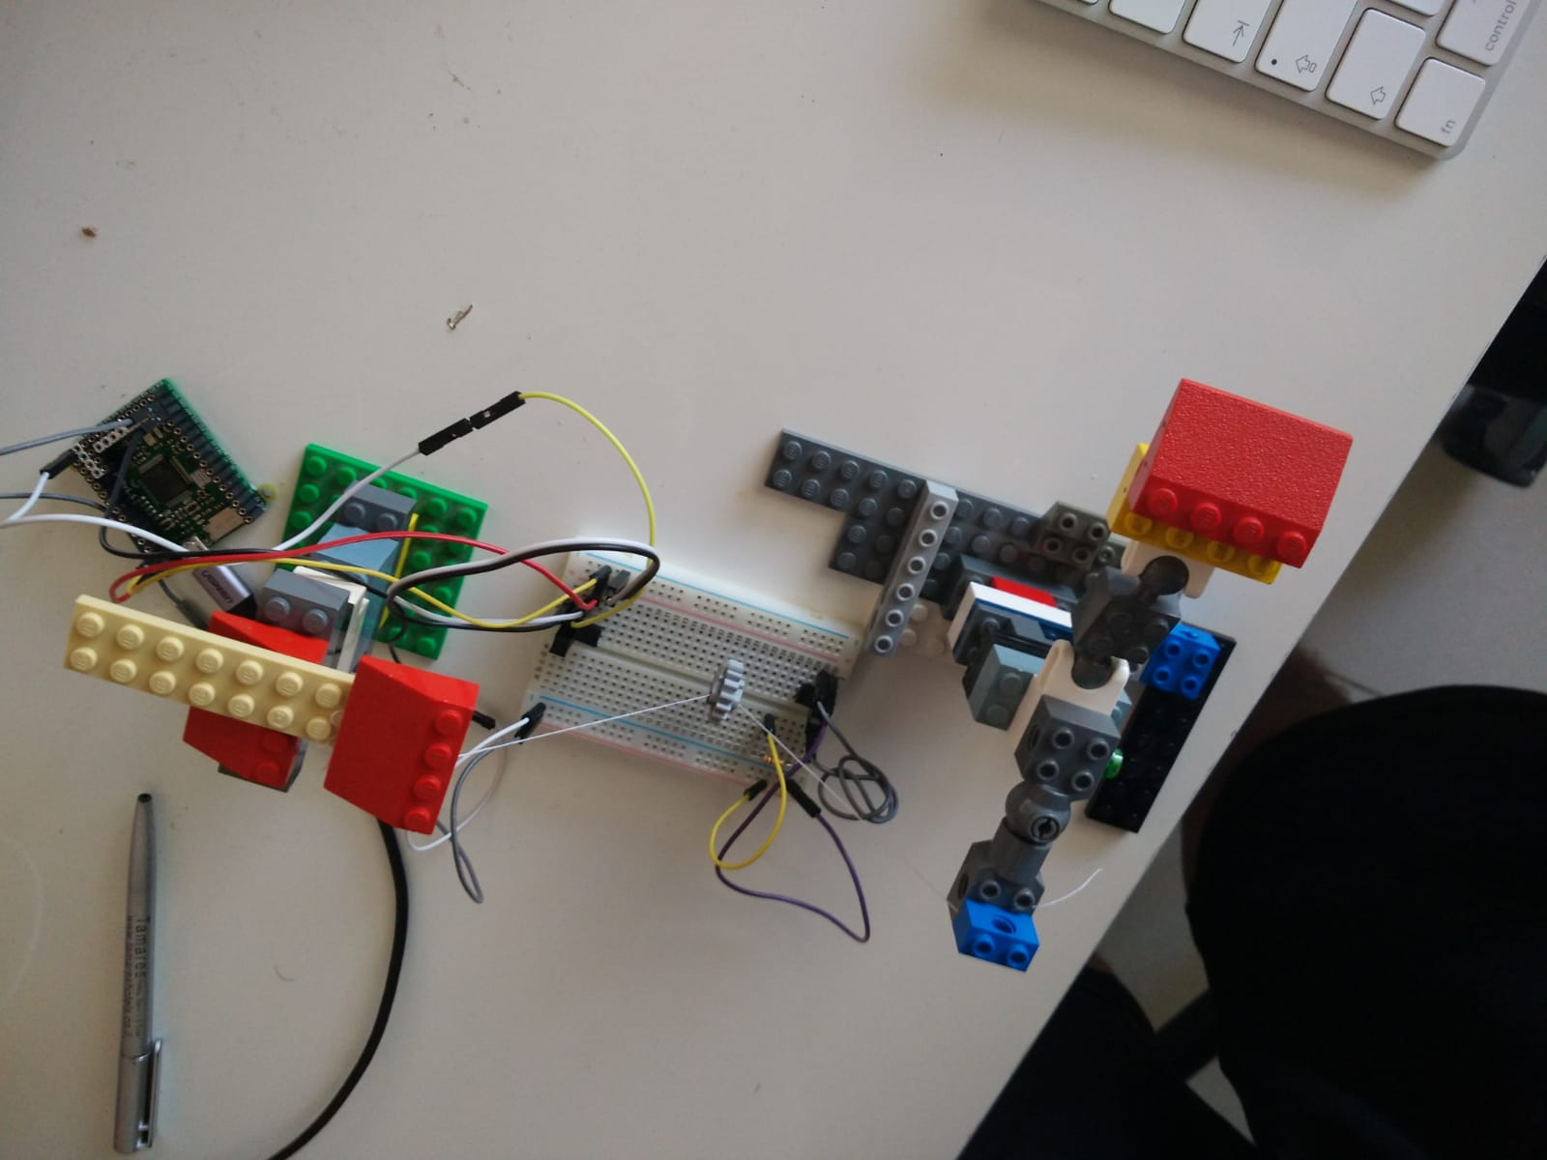
Pendulum axes points
String 1
String 2
mass
Side view 1
Side view 2
Top view. The microcontroller communicates to the computer the time in which the pandulum mass broke the Infrared beem.
Infrared LED
Infrared sensor
Microcontroller

